Slide 1
🏏
CAPSTONE PRESENTATION
Cricket Research
Answer Bot
A Retrieval-Augmented Generation system for question answering over cricket research papers
Manoranjith | GenAI Capstone Project | August 2026
RAG
VECTOR DATABASES
LLMS
LANGCHAIN

Slide 2
PROBLEM STATEMENT
LLMs know a lot — but not your papers
Large language models answer from what they memorized during training. They cannot see a curated, private set of cricket research papers, and when asked about them anyway, they tend to guess — confidently.
🎯
🏁
⚠️
Business Context
The Goal
Why It's Hard
Acting as a curated cricket-analytics archive, we need a chatbot that can answer questions grounded in a specific set of cricket research papers — analytics, biomechanics, and strategy.
Index papers into a vector database, retrieve the most relevant passages for a query, and generate answers that cite the exact paper and page they came from.
It isn't enough to build any RAG pipeline — the brief asks us to try multiple embedding models and retrieval strategies, and justify the final choice with evidence.
CRICKET RESEARCH ANSWER BOT
2

Slide 3
SYSTEM DESIGN
End-to-end RAG architecture
🏏
✂️
🧬
🗄️
🔎
🤖
→
→
→
→
→
PDF Papers
Load & Chunk
Embed
ChromaDB
Retrieve
Generate
3+ cricket papers
PyPDFLoader + recursive splitter
bge-m3 / text-embedding-004
vector store + metadata
dense / hybrid BM25 + cosine
Google Gemini → grounded answer
The final answer always returns the top-3 supporting passages (paper title + page number) alongside the generated text, so every claim is traceable back to its source.
WHY THIS SHAPE?
Indexing (left half) happens once, offline. Querying (right half) happens on every user question, reusing the same index — this separation is what keeps the app fast after the first run.
CRICKET RESEARCH ANSWER BOT
3

Slide 4
DATA & CHUNKING · 1/2
Dataset: 3 cricket research papers
3 original PDFs covering core cricket-analytics topics — data analytics & ML in cricket, fast-bowling biomechanics & injury prevention, and T20 powerplay / death-over strategy — used to build and validate the pipeline end-to-end. The same pipeline works unchanged on any PDF dropped into the papers folder, including real published cricket-analytics or sports-science papers.
📈
🦴
⚡
Paper 1 — Cricket Analytics
Paper 2 — Bowling Biomechanics
Paper 3 — T20 Strategy
Data analytics & machine learning in modern cricket: win-probability models, player performance prediction.
Biomechanics of fast bowling: action phases, injury risk, and workload management.
Powerplay aggression, death-over bowling variation, and matchup-based field-setting analytics.
LOADER: PyPDFLoader
METADATA RETAINED PER CHUNK
Returns one Document per page with page number already in metadata — exactly the granularity citations need.
paper_title, source_file, page_number, chunk_id — carried through chunking automatically.
CRICKET RESEARCH ANSWER BOT
4

Slide 5
DATA & CHUNKING · 2/2
Chunking strategy: recursive character splitting
RecursiveCharacterTextSplitter — chunk_size=700, chunk_overlap=120
Fixed-size chunking
CHOSEN
Recursive character splitting
Semantic chunking
Cuts at a fixed character count. Simple, but can slice a sentence in half mid-thought.
Splits on paragraph breaks first, then lines, then sentences — only hard-cutting as a last resort. Keeps chunks coherent.
Splits on topic shifts detected via sentence embeddings. More precise, but slower and adds an extra embedding pass per document.
THE SIZE TRADE-OFF
Too small → loses surrounding context needed to interpret a passage.
Too large → mixes multiple ideas, diluting the embedding and hurting retrieval precision.
CRICKET RESEARCH ANSWER BOT
5

Slide 6
EMBEDDINGS
Two embedding models, compared
🧩
BAAI/bge-m3
💳
text-embedding-004
Open-source — Hugging Face
Commercial — Google Gemini API
Runs locally via sentence-transformers
Called over the network, no local setup
Free, no API key, no per-call cost
Small per-token cost, very low latency
Needs local compute (CPU works for small corpora)
Maintained & updated by the provider
OBSERVATION FROM TESTING
Both models correctly surfaced the right passage as the #1 result for most test queries. text-embedding-004 was marginally more precise on queries phrased differently from the source wording; bge-m3 performed comparably at zero marginal cost. Each is indexed into its own ChromaDB collection so they never overwrite one another.
CRICKET RESEARCH ANSWER BOT
6

Slide 7
VECTOR DATABASE & RETRIEVAL
ChromaDB + two retrieval strategies
VECTOR DB: ChromaDB (local)
Stores metadata (paper title, page) alongside every vector natively — FAISS would need a separate lookup table for the same result.
Dense Retrieval (Cosine)
Hybrid (BM25 + Dense)
Embeds the query and returns the chunks closest by vector similarity. Strong when query wording matches the source text.
Combines keyword scoring (BM25) with dense similarity via rank fusion. Catches exact technical terms dense search alone can miss.
FINAL SELECTION: HYBRID RETRIEVAL
Hybrid consistently surfaced BM25-favoured chunks containing the query's exact technical term (e.g. “acute:chronic workload ratio”, “powerplay”) in its top-3, which dense-only retrieval sometimes ranked lower or missed when phrasing differed from the source text.
CRICKET RESEARCH ANSWER BOT
7

Slide 8
RAG PIPELINE
Wiring retrieval + generation together
Built with LangChain LCEL: retriever → format context → prompt → Gemini → answer
🎯
Context-only grounding
Answer ONLY from the retrieved context — never fall back on the model's own trained knowledge.
🤖
LLM: Google Gemini
❓
“I don't know” fallback
Supports toggling between 3.1-flash-lite, 3.1-flash, and 3.1-pro to balance speed vs. reasoning depth based on query complexity and user preference.
If the context is insufficient, say so explicitly instead of guessing — the single biggest lever against hallucination.
🏷️
Inline citation labels
Each passage is labeled with its paper title + page number directly in the prompt, so the model can reference them naturally.
CRICKET RESEARCH ANSWER BOT
8

Slide 9
RESULTS & DEMO
Sample Q&A with source citations
10
test questions
across all papers
Q
“What is the acute:chronic workload ratio and why is it tracked?”
A
It is the ratio of a bowler's recent (acute) workload to their longer-term (chronic) workload. A sudden spike well above 1.0 is associated with substantially elevated injury risk, so squads track it closely across training and matches, not just in matches.
Top-3
sources shown
per answer
TOP-3 SOURCES
1. Paper 2 — Fast Bowling Biomechanics, p.2
1
out-of-scope query
correctly refused
2. Paper 2 — Fast Bowling Biomechanics, p.3
3. Paper 1 — Cricket Analytics, p.1
Every answer is traceable back to the exact paper and page it was generated from.
CRICKET RESEARCH ANSWER BOT
9

Slide 10
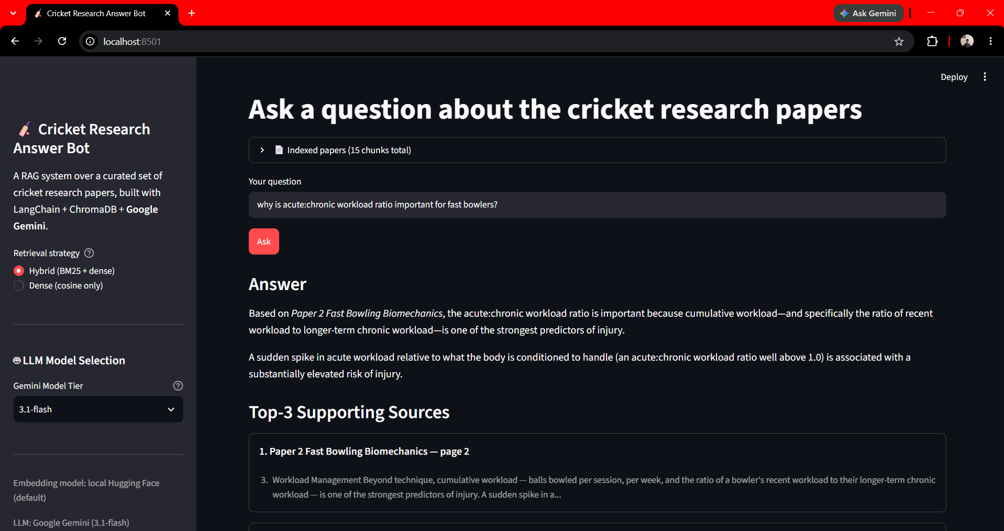
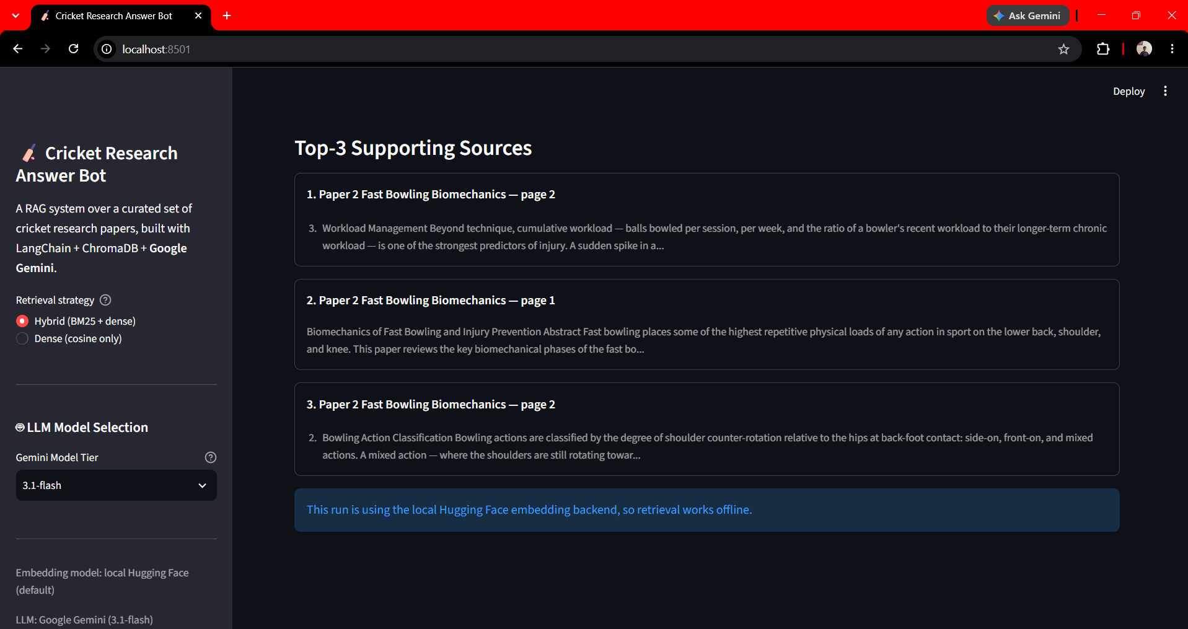
LIVE DEMO
Live application walkthrough
Screens captured from the deployed app
🖼️
🖼️
Screenshot — Query Input & Generated Answer
Screenshot — Source Citations & Page View
CRICKET RESEARCH ANSWER BOT
10

Slide 11
STRETCH GOAL · ADVANCED OPTION 2
A polished Streamlit UI
Built a Streamlit application (app.py) on top of the same pipeline used in the notebook — no logic duplicated, both share the exact modules in src/.
Query input box + Ask button
$ streamlit run app.py
Generated answer displayed prominently
Top-3 supporting passages shown with paper title + page number
Sidebar toggle to switch between dense and hybrid retrieval live
Deployed via Streamlit's own free hosting for the live demo during mentor review.
Same src/ modules power both the notebook and the app — nothing can drift out of sync.
Cached indexing (@st.cache_resource) — instant after first run
CRICKET RESEARCH ANSWER BOT
11

Slide 12
CHALLENGES & LEARNINGS
What was hard, and what it taught me
🧵
Chunking prose vs. lists
🔀
Dense vs. hybrid disagreement
Section headings inside PDF text sometimes got glued to the following paragraph; tuning separators to try line breaks before sentences fixed most cases.
The two retrievers agreed most of the time, but hybrid's edge only showed up on queries using exact domain terms — a useful reminder to test with realistic, jargon-heavy questions.
📦
Library version drift
🎚️
Balancing model tiers
LangChain's 1.x restructuring moved retriever classes used here; pinning to the stable 0.3.x line kept the notebook reproducible.
3.1-flash-lite is fast but occasionally under-explains; 3.1-pro is noticeably slower. 3.1-flash was the best default for demo responsiveness.
CRICKET RESEARCH ANSWER BOT
12

Slide 13
CONCLUSION
Project summary
Loader
PyPDFLoader — per-page metadata for citation
Chunking
RecursiveCharacterTextSplitter, 700 / 120
Embeddings
bge-m3 (open-source) + text-embedding-004 (commercial)
Vector DB
ChromaDB, local, metadata-native
Retrieval
Dense (cosine) + Hybrid (BM25 + dense) — hybrid selected
LLM
Google Gemini — toggle between 3.1-flash-lite / 3.1-flash / 3.1-pro
Stretch goal
Streamlit UI with live retrieval-strategy toggle
FUTURE IMPROVEMENTS
Cross-encoder re-ranking on top of hybrid retrieval • conversational memory for multi-turn Q&A • RAGAS / DeepEval for automated, repeatable scoring • expand corpus with real published cricket-analytics papers
CRICKET RESEARCH ANSWER BOT
13

